Slide 1
FIRE/FLAME DETECTION SENSOR
İsmail alperen Aytekin

Slide 2

Purpose
The aim of this project is to be able to detect flame and measure temperature value using senshub and flame sensor sensor through tm4c1294ncpdt launcpadi.

Slide 3
MATERIAL LIST
Tiva C Series – EK-TM4C1294XL
BOOSTXL-SENSHUB Sensor Hub BoosterPack
Flame detection sensor
Female to male jumper
Ethernet connection provider cable

Slide 4
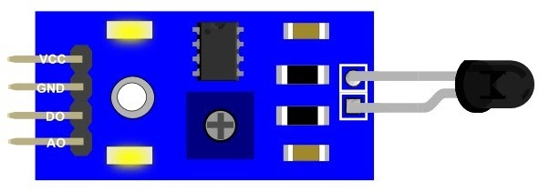
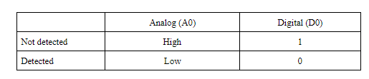
INFORMATION OF FLAME DETECTION SENSOR
Detects fire, it detects light source and sensitive to light with wavelength of 940nm
Interface: Analog or digital
Supply Voltage: +5 V
Detection range: 20 cm (1V) ~ 100 cm (4.8V)
Interface with microcontrollers and logic circuits

Slide 5
METHODOLOGY

Slide 6
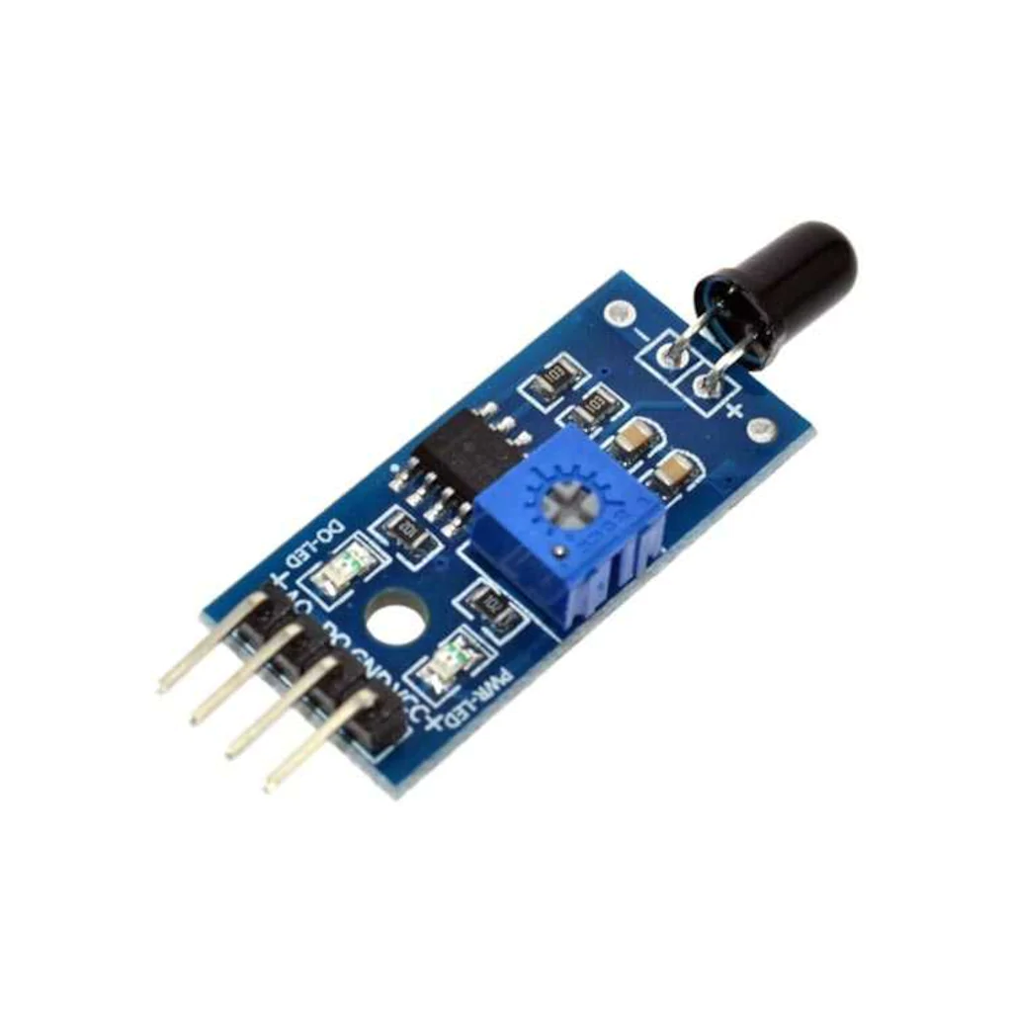
First, the connection of our sensors to the launchpad was made to the corresponding ports.
First, it has been tested by powering our sensors. After that, our sensors were connected to the launchpad to the corresponding ports.
By coding the connected sensors through the application, an attempt was made to achieve the correct result by trial and error.

Slide 7
Project outcomes

Slide 8
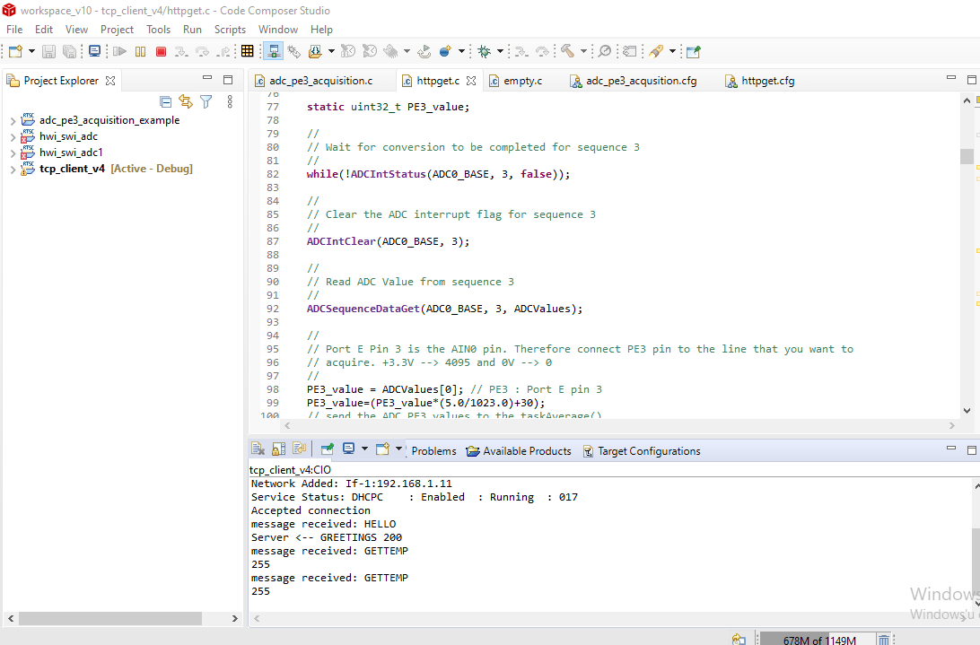

Slide 9
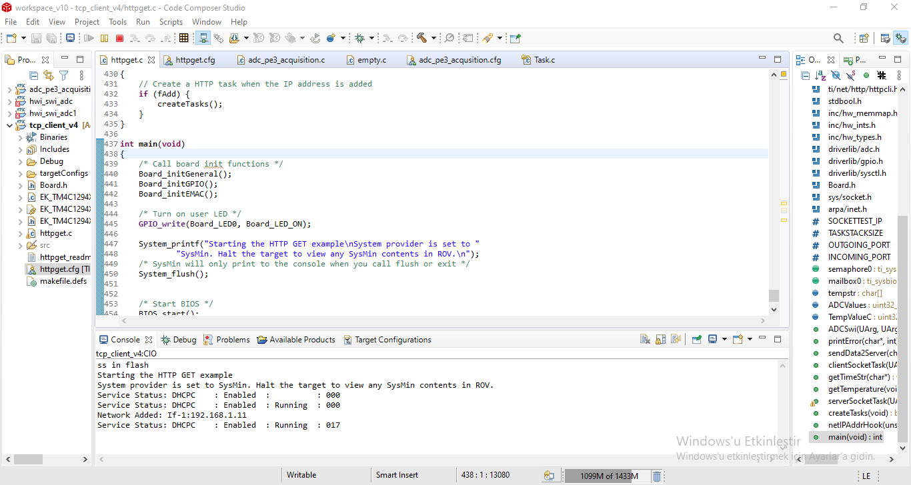
One outcome of the flame detection project

Slide 10
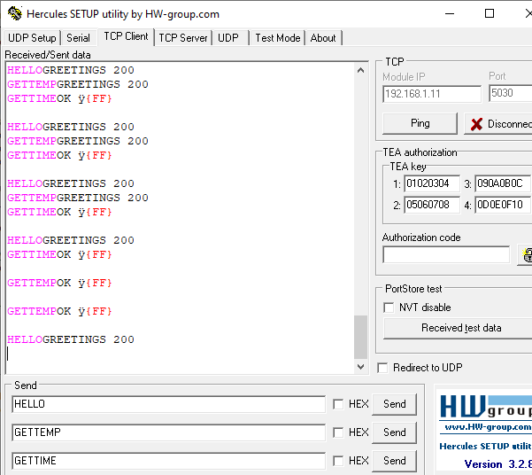
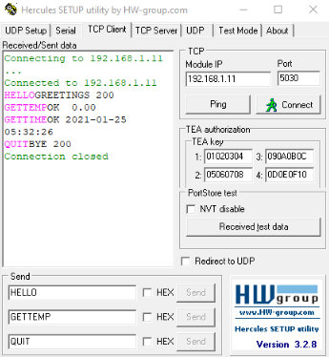
OUTPUTS HERCULES

Slide 11
Problems Encountered
Flame detection sensor - launcpad connection
Lack of material and time
Programming difficulties
Computer failure as a special problem

